Slide 1
ENPM695 Secure Operating Systems
Jonas Amoonarquah

Slide 2
Who am I?
IT Security Specialist - Division of IT, UMD
Lead forensic analyst (Lots of stories)
17+ years of experience in IT field
8 years Information Security

Slide 3
Course schedule
Presentations and assignments will be uploaded to ELMS prior to class

Slide 4
Office Hours
Tuesdays – 11:30am – 12:30pm
In person – Manokin Bldg. 5801 University Research ct. Dedicated shuttle bus every 30min.)
Online via Webex: https://umd.webex.com/join/jamoonar
Also by appointment (in person or online)

Slide 5
Contact Info
ELMS/Canvas Message System (Preferred)
jamoonar@umd.edu - Best way to reach me. *Please put “[ENPM695]” in the subject line so I don’t miss it in the enormous amounts of email that flow through my inbox
Phone - I’m not always in my office but I usually check my voicemail 301-405-8398

Slide 6
Grading
Roughly:
Homework = 33% (5 assignments)
Midterm = 33%
Final = 33%
*Possible project may adjust these values

Slide 7
+/- Grading
It’s University Policy (if a little silly)
A+ = 100 – 97
A = 96 – 93
A- = 92 – 90
B+ = 89 – 87
B = 86 - 83
B- = 82 – 80
C+ = 79 – 77
C = 76 – 73
C- = 72 – 70
D+ = 69 – 67
D = 66 – 63
D- = 62 – 60
F = 59 and below

Slide 8
Grading
Learn the content of focus and you’ll do fine.
If you don’t understand something or have concerns speak up/reach out as soon as possible! The earlier the better

Slide 9
Grade Disputes
If you spot a mistake in your assignments/grades then contact me ASAP and we’ll get it resolved.

Slide 10
Notice
If you didn’t do the assignment, admit it.
If you don’t understand the assignment, ask for help early.
If you didn’t study or put any effort into the assignment accept the grade and resolve to do better (with my help if needed) next time

Slide 11
Notice
This course is not a democracy.
This is my class.
My main purpose here is to:
To teach you and to help you learn/grow ☺
I’ll do my part, the rest is up to you

Slide 12
Assignments
There are 5 homework assignments total
We may also have a class participation exercise, with notice given for adequeate preparation

Slide 13
Exams
This class has a Midterm and a Final Exam

Slide 14
(Potential)Class Participation
We may have class participation exercises.
Bring your experiences to the group
Start and engage in class discussions in ELMS so both in person and online students can participate.

Slide 15
Late Assignment Policy
Late assignments will have 10% of the points deducted for every day the assignment is late.
ex. You turn in a “10” it gets a “9”
Assignments submitted over one week late will not be accepted or graded.
aka you get a zero.
If there are extenuating circumstances for you to submit work late please contact me as soon as possible (preferably before the assignment is due.)

Slide 16
Academic Integrity
The University of Maryland, College Park has a nationally recognized Code of Academic Integrity. This Code sets standards for academic integrity at Maryland for all undergraduate and graduate students. As a student you are responsible for upholding these standards for this course. It is very important for you to be aware of the consequences of cheating, fabrication, facilitation, and plagiarism. For more information on the Code of Academic Integrity or the Student Honor Council, please visit http://www.shc.umd.edu

Slide 17
Honor Pledge
All assignments and exams for this course are governed by the Honor Pledge: “I pledge on my honor that I have not given or received any unauthorized assistance on this exam/assignment.”

Slide 18
Cheating…
DON’T
you will fail DO you will fail
IT

Slide 19
Recommended Textbooks
NOT required, but very very useful:
Operating System Security by Jaeger, Trent (9781598292138) SKU:9781598292138 - 05 MORGAN+C C Security Strategies in Linux Platforms and Applications
by Jang (9781284110289) SKU:9781284110289 - 2ND 17 JONES+B CO Building Secure Software by Viega (9780321624000) SKU:9780321624000 - 02 PEARSON CO

Slide 20
Course Schedule
Review the Syllabus
Today is Lecture one only

Slide 21
Feedback is a Blessing
Please let me know if you find something lacking or have specific tools/techniques you’d like to see or discuss.
Don’t be afraid to share your honest opinion
Feedback should be specific
Feedback should be descriptive
Feedback should be timely

Slide 22
Technical Issues
With ELMS: elms@umd.edu
With the recorded lectures: dets-support@umd.edu or http://www.dets.umd.edu/
VMs or tools discussed in class:
Google***
Send me an e-mail

Slide 23
Background
Operating System Security is a big challenge
Why?
Not just the security of the operating system code
Not just the security of the operating system functions
Multi-faceted
Code
Libraries
Functionality
Kernel
Applications

Slide 24
What Makes an Operating System Secure?
Code
Features
Services provided
Software running at a given time
Capabilities
Tamperproof
Reference monitor
Attack Surface

Slide 25
Reference Monitor
Set of design requirements for a validation mechanism
Enforces access control over users and processes
Ability to perform actions on files and sockets (network and otherwise)
Must be
Non-bypassable
Evaluation
Always available
Tamperproof

Slide 26
Why do we need security?
A study by Aspect Security and Sonatype of how 31 popular open-source code libraries were downloaded in 2012 found that more than a third of the 1,261 versions of these libraries had a known vulnerability and about a quarter of the downloads were tainted
19.8 million (26%) of the library downloads had known vulnerabilities
“Today's applications commonly use 30 or more libraries, which can compromise up to 80% of the code in an application," according to the study
The impact of a vulnerability depends greatly on how the library is used by the application.
http://www.networkworld.com/news/2012/032612-open-source-vulnerabilities-257645.html

Slide 27
And Then There’s Compliance
EU directive:
Article 23,24 & 79, - Administrative sanctions
“The supervisory authority shall impose a fine up to 250,000 EUR, or in case of an enterprise up to 0.5 % of its annual worldwide turnover, to anyone who, intentionally or negligently does not protect personal data”
http://register.consilium.europa.eu/pdf/en/12/st05/st05853.en12.pdf

Slide 28

An Inconvenient Truth
2 weeks of ethical hacking
Code
Flaws
Business
Logic Flaws
Security
Errors
10 man years of development

Slide 29
Gauging the Threat
The risk of producing insecure software systems can be evaluated by
Looking at historic risk.
The potential for future attacks.
Historic risk can be measured by
Looking at the type.
Cost of perpetrated crimes.
The potential for future attacks can be partially gauged by:
Evaluating emerging threats.
The security of existing software systems.

Slide 30
What is the Cost?
Based on conservative estimates, about 100,000 new software vulnerabilities were present in 2010 alone.
The number of security incidents worldwide swelled to about 400,000 a year, or 8,000 per work week [Berinato 04].

Slide 31
Some Historical Examples
July 2001 – Code Red I – worm to attack
August 2001 – Code Red II - worm for backdoor

Slide 32
Running With Scissors
The W32.Blaster.Worm
Discovered on August 11, 2003.
Infected unpatched system connected to the Internet without user involvement.
At least eight million Windows systems have been infected by this worm [Lemos 04].
Economic Damage > $500M$

Slide 33
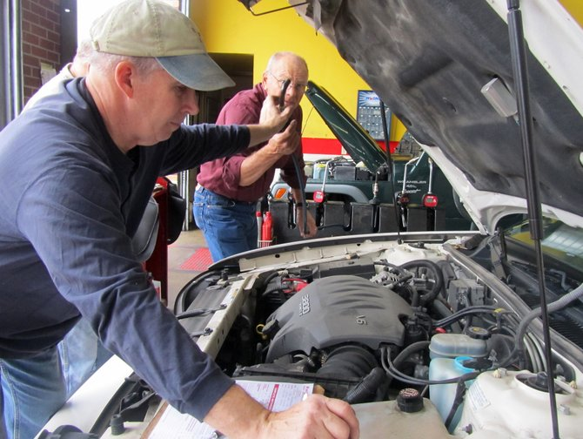
Peeking under the hood…
Checks to see if the computer is already infected.
Adds “windows auto update” = “msblast.exe” to registry key HKEY_LOCAL_MACHINE\SOFTWARE\Microsoft\Windows\ CurrentVersion\Run
Runs when Windows starts.
Generates a random IP address.
Attempts to infect the computer with that address.
Sends data on TCP port 135 to exploit the DCOM RPC vulnerability on either Windows XP or Windows 2000.

Slide 34
Who is the Threat?
Threat is a person, group, organization, or foreign power that has been the source of past attacks or may be the source of future attacks.
Threats include:
Hackers
Insiders
Criminals
Competitive Intelligence Professionals
Terrorists
Information Warriors.

Slide 35
Hackers
Motivated by curiosity and peer recognition from other hackers.
Write programs that expose vulnerabilities in computer software.
The methods used to disclose these vulnerabilities varies from a policy of responsible disclosure to a policy of full disclosure.

Slide 36
Insiders
The threat comes from a current or former employee or contractor of an organization.
Has legitimate access to the information that was compromised.
Do not need to be technically sophisticated to carry out attacks.
Technically sophisticated insiders can launch attacks with immediate and widespread impact.
Technical insiders can cover their tracks.

Slide 37
Criminals
Common crimes include:
Auction fraud,
Identity theft.
Extortion.
Phishing
Lure victims to fake website to gather account data.
Pfarming
Exploit DNS vulnerabilities to redirect web traffic to malicious site.

Slide 38
Competitive Intelligence Professionals (CIP)
Corporate spies:
Call themselves competitive intelligence professionals.
Have their own professional association—the Society for Competitive Intelligence Professionals (SCIP).
May work from inside a target organization, obtaining employment to steal and market trade secrets.
Conduct other forms of corporate espionage.

Slide 39
Terrorists
Cyber-terrorism can be defined as unlawful attacks or threats of attack against computers, networks, and other information systems to intimidate or coerce a government or its people to further a political or social objective [Denning 00].

Slide 40
Information Warriors
Eight nations have developed cyber-warfare capabilities comparable to that of the United States.
More than 100 countries are trying to develop them.
Twenty-three nations have targeted U.S. systems.

Slide 41
Software Security
The CERT/CC monitors public sources of vulnerability information and regularly receives reports of vulnerabilities.

Slide 42
Vulnerabilities Reported to CERT/CC and NVD (1995 – 2013)
2013 only includes vulnerabilities from Q1.
CERT/CC note on statistics

Slide 43
Definition of Computer Security
“A computer is secure if you can depend on it and its software to behave as you expect”
Extends beyond computers
Routers
Switches
Firewalls
Anything that runs an “operating system”
We tend to get obsessed with “computer security” but it’s a wider topic
Garfinkel, S., Spafford, G. and Schwarz, A. “Practical Unix and Internet Security, 3rd ed., O’Reilly, California, USA

Slide 44
Components of Security
Confidentiality
The ability of a system to ensure the privacy and secrecy of information
Note – we don’t say the “security” of information
Integrity
The ability of a system to ensure that information (data, etc.) is not altered while it is at rest or during transmission
Availability
The ability of a system to ensure that information (data, etc.) is available when requested without undue delay

Slide 45
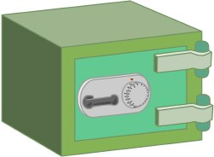
Is This Secure?

Slide 46
A More Realistic View
User
Threat
Threat
Threat
DB Admin
System/Network
Admin

Slide 47
Perspective
Macro
Look at the “big” picture
Operating system configuration
Users
Processes
Privileges
Applications
Micro
Software Code
OS operations

Slide 48
Overview
Key functions on an operating system?
Multi-tasking/multi-sharing
Resource management
Activity flow control
Enforce security measures
Schedule processes
Provide tools to configure the OS and hardware

Slide 49
Functions of the Operating System
An intermediary between the user application and the underlying hardware
Provide an abstraction layer to the user/programmer
Provide a set of services
Virtual machine (hypervisor)

Slide 50
Operating System Layers
Lugo-Cordero, Hector M. “Operating Systems and Virtual Machines Security”, Accessed at http://www.cs.ucf.edu/~hlugo/cis4361/private/lectures/11-Operating Systems Security.ppt

Slide 51
Operating System Functions
Services/Hypervisor
Primary function of an operating system
Consists of core utilities
UNIX: initd, login
Windows: svchost.exe
Provides access to OS and features
Includes
User authentication
Administrative tasks

Slide 52
The Challenges
Two fundamental challenges
User authentication
What is authentication?
How to reliably authenticate?
User authorization
Who is authorized to do What?

Slide 53
Authentication
User authentication
Passwords
What you know
Multi-Factor authentication
Who you are
What you know
What you have
Multi-Factor authentication can take many forms
Biometrics
Retina
Fingerprint
Voice

Slide 54
Authorization
Definition
Authorization is the specification of access rights to resources in a system leveraging an access control model
Formal models of access control
Mandatory
Discretionary
Relies on authentication
Authentication failure can lead to authorization failure
Why “can”?

Slide 55
Access Control*
Mandatory Access Control
Definition: “When a system mechanism controls access to an object and an individual user cannot alter that access, the control is a mandatory access control (MAC)”
Also known as “Role-based access control (RBAC)”
Discretionary Access Control
Definition: “If an individual user can set an access control mechanism to allow or deny access to an object, that mechanism is a discretionary access control (DAC)”
Also known as “identity-based access control (IBAC)”
Bishop, Robert, “Computer Security, Art and Science”, Addison-Wesley, 2003, p. 103

Slide 56
Security Policy
Formal models of security policy
Form the bedrock of access control
Must cover specific properties
Confidentiality
Integrity
Availability
Confinement
Identity
Anonymity
Non-repudiation

Slide 57
Bell-La Padula
Developed by David Bell and Leonard La Padula in 1973
Developed in 1973
Mandatory Policy
Preserves confidentiality
Subjects are assigned a classification
Public
Confidential
Secret
Top-Secret
Subjects can only read information at their classification or lower (read down)
Subjects can only write information to equal or higher classification levels (write up)

Slide 58
Biba
Developed by Kenneth Biba in 1975
Also a mandatory policy model
Focus is on integrity of information
Subjects and objects are assigned an integrity level
Lowest
Low
High
Highest
Subjects can only read information at their integrity classification or higher (read up)
Subjects can only write information to equal or lower classification levels (write down)

Slide 59
Clark-Wilson
Developed by David Clark and David Wilson in 1987
Mandatory model
Like Biba – designed to ensure integrity of information
Data is either constrained or unconstrained
Constrained implies that the data is subject to integrity controls
Unconstrained data is not subject to integrity controls
Two procedures
Integrity verification – tests to ensure that CDI conform to constraints at the time IVP occurs
Transformation – change the state of data from one valid state to another

Slide 60
Chinese Wall
Developed by David Brewer & Michael Nash 1989
Mandatory
Refers equally to confidentiality and integrity
Is as important to business as Bell-LaPadula is to military
Goal is to prevent conflict of interest
Stock trader with two clients
Information is organized in 3 levels
Lowest level - individual items
Middle level - information grouped by corporation
Highest level - corporations in competition grouped together
Highest level groupings form conflict of interest classes
Information may be accessed by a user only if it does not conflict with any other information he holds

Slide 61
Other Topics of Consideration
Race Conditions
Occurs when a pair of calls in an application do not execute in the sequential manner that was intended
Consequences/Impacts:
Authentication
Integrity
Confidentiality
Time of Check to Time of Use (TOCTTOU)
Consequences/Impacts
Access control
Authorization
Integrity
Accountability
Non-Repudiation

Slide 62
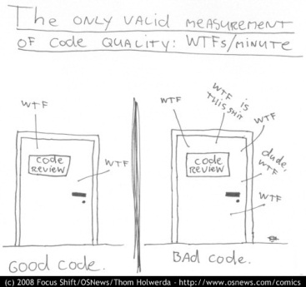
Final thoughts

Slide 63
Upcoming
Assignment #1 available on Tuesday February 8th 2022
Due on Tuesday February 15th 2022
Next class: Tuesday, February 8th 2019
Threats, Attacks and Exploits part 1

